Slide 1
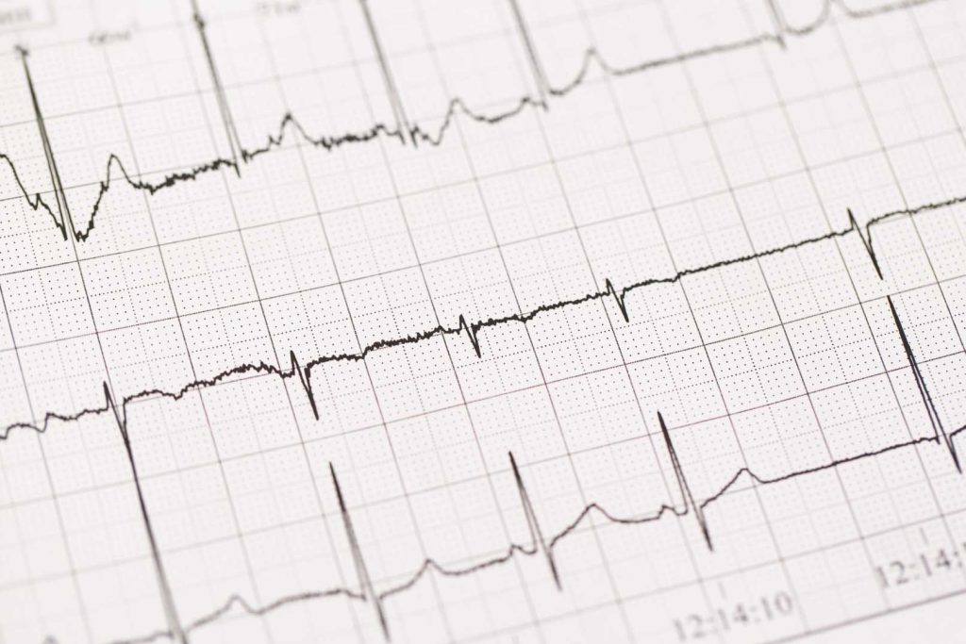
A robust fetal ECG detection method for abdominal recordings
S. M. M. Martens, C. Rabotti, M. Mischi and R. J. Sluijter, A robust fetal ECG detection method for abdominal recordings, Physiological Measurement, 28, 373, 2007
Marta Stefanelli – 84393A

Slide 2
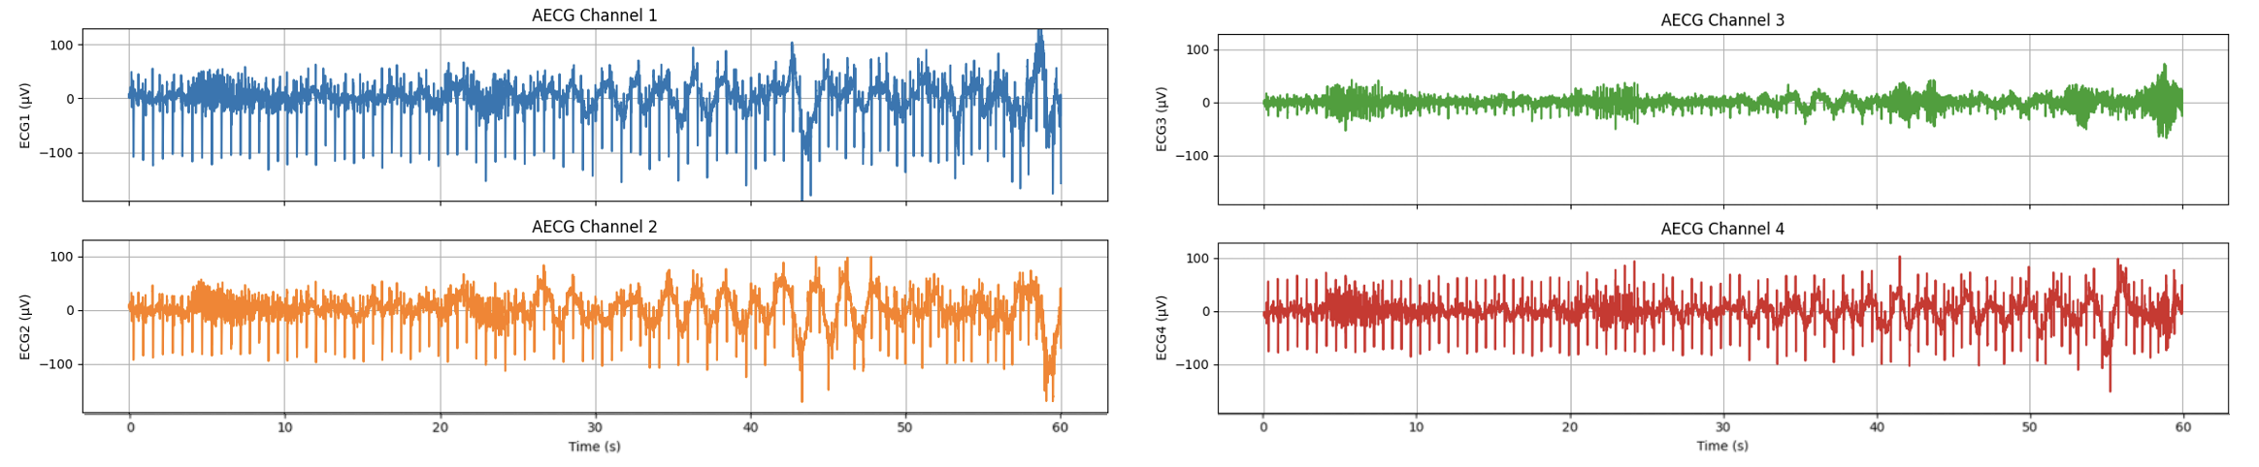
The dataset
Set-A from Physionet.org, all the plot are related to a14.
1. ECG signals
Duration = 1 min
F_{s} = 1000 Hz
2. QRS annotation
It is composed of a sequence of numbers that correspond to the positions, in milliseconds, of the true FQRS peaks.
1 of 10

Slide 3
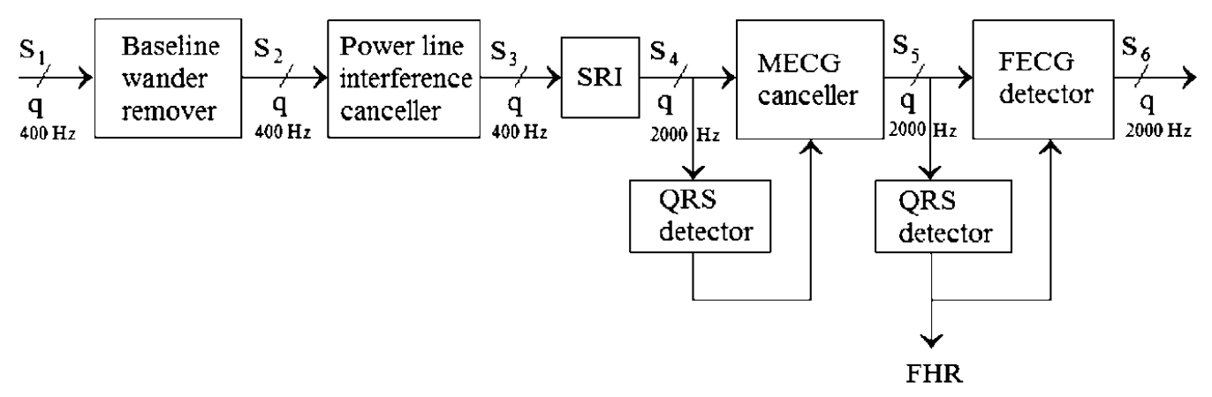
The paper
Baseline wander removal
Power line interference canceller
Upsampling
MQRS detection
MECG canceller
FQRS detection
FECG deteciton
2 of 10

Slide 4
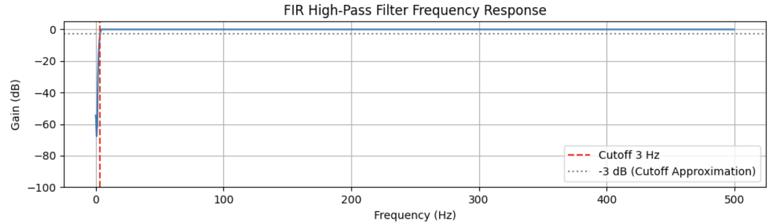
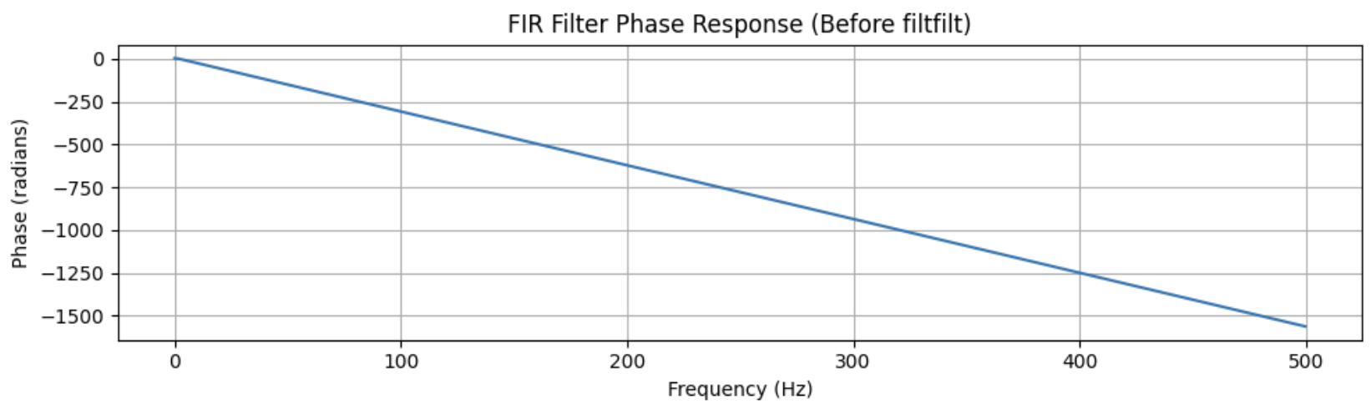
1. Baseline wander removal
S1 -> S2
Cause: movement and respiration of the patient.
Solution: FIR high-pass filter with a cut-off frequency at 3 Hz.
3 of 10

Slide 5
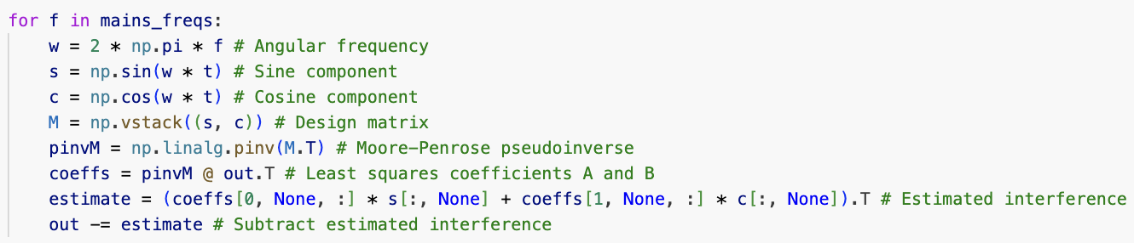
2. Power line interference canceller
S2 -> S3
Cause: disturbance of the electric current.
Solution: adaptive noise cancellation using harmonic frequences of the fundamental frequency 50 Hz.
4 of 10

Slide 6
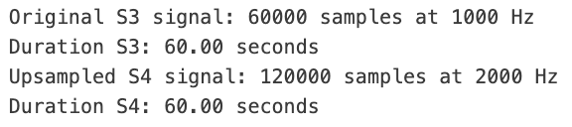
3. Upsampling
S3 -> S4
Done by using the scipy.signal.resample function.
5 of 10

Slide 7
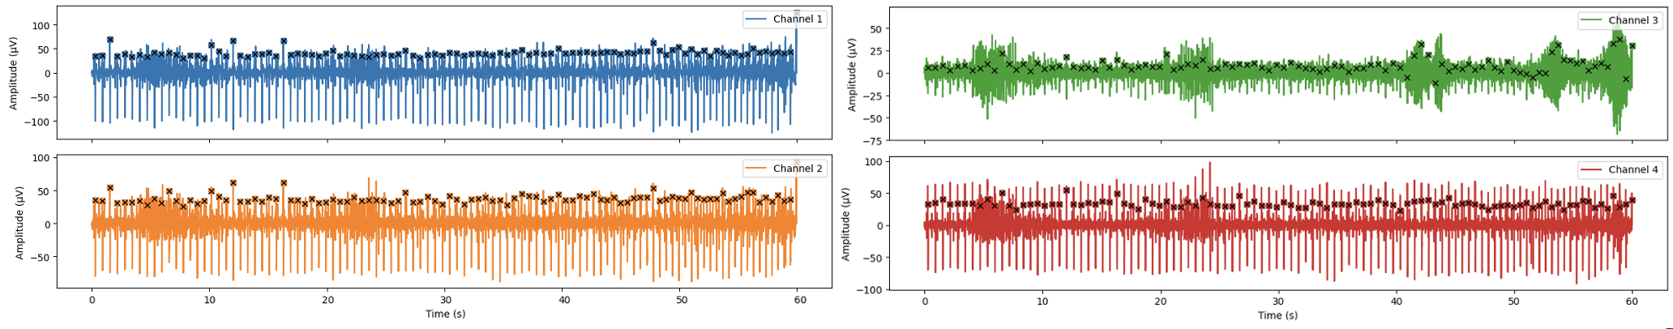

4. MQRS detection
S4 transformation
PCA firs component (pca_firs_component)
MQRS template (build_qrs_template)
Cross correlation (detect_qrs_corsscorr)
6 of 10

Slide 8
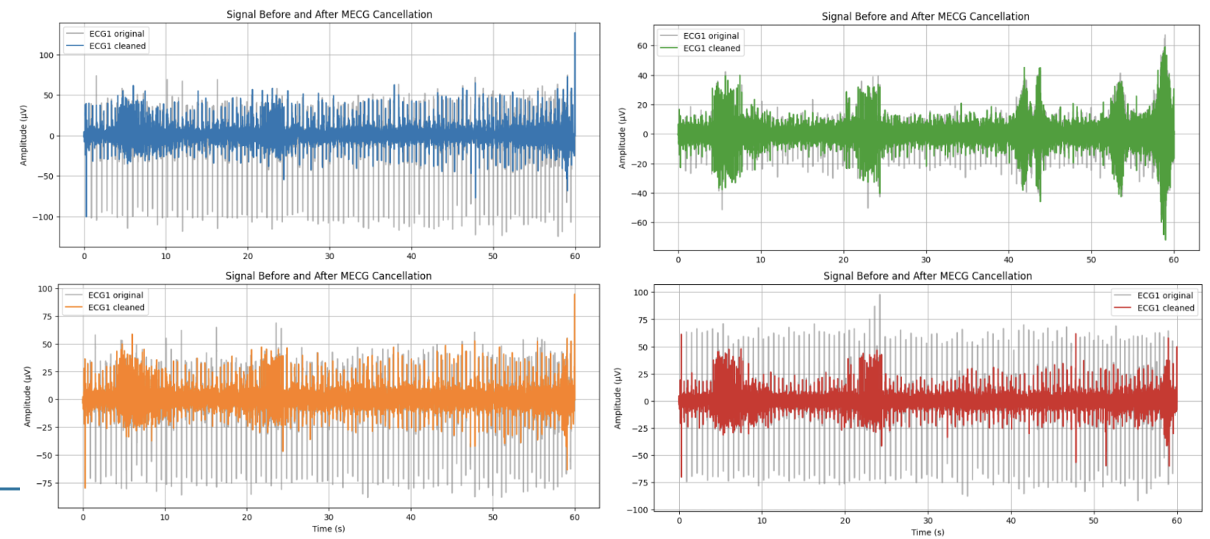
5. MECG canceller
S4 -> S5
10 preceding maternal heartbeats
Different scale factors
Subtraction between the signal and the estimate mother ECG
7 of 10

Slide 9
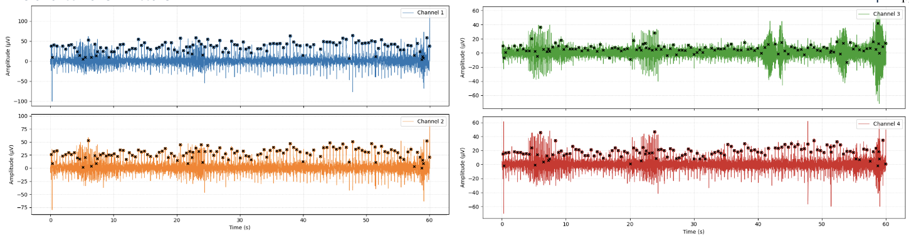

6. FQRS detection
S5 transformation
 | FQRS detection | MQRS detection
High-pass cutoff | 4 Hz | 1 Hz
Percentile | 96 | 98
Refractory | 0.12 s | 0.28 s
Refinement | 15 ms | 20 ms
8 of 10

Slide 10
6. FQRS detection
S5 transformation
Mean R-R Interval: 470.73 ms
Estimated Fetal Heart Rate (FHR): 127.46 BPM
8 of 10

Slide 11
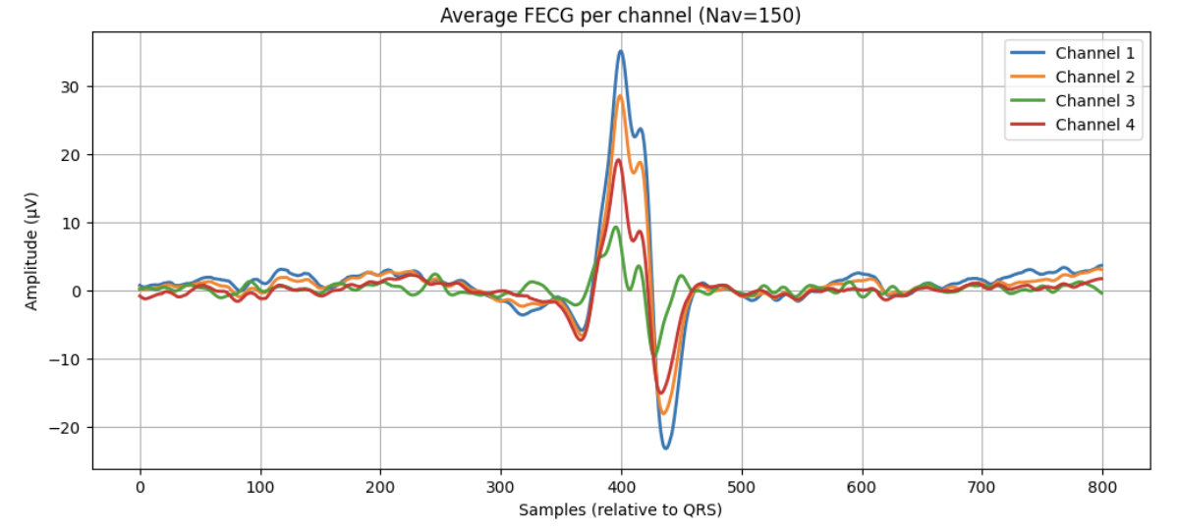
7. FECG detection
S5 -> S6
N_{av} = 150 => SNR increase by a factor of $\sqrt{N_{av}}$ = 12
9 of 10

Slide 12
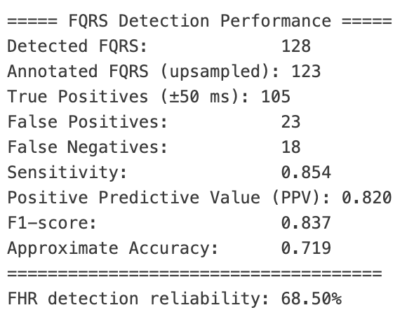

Performance metrics and results
FQRS detection performances
Signal S1
Signal S5
10 of 10

Slide 13
Performance metrics and results
FQRS detection mean performances
Sensitivity | FHR Reliability | F1 | Accuracy
40,62196 | 55,493% | 0,64572 | 55,744%
10 of 10

Slide 14
Thank you
Marta Stefanelli – 84393A

